Slide 1
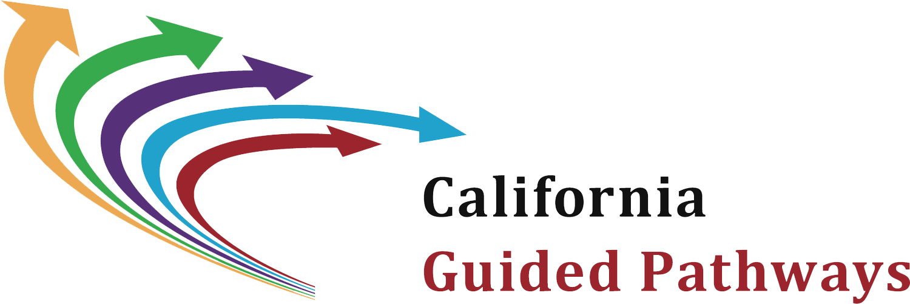
Reducing Student Equity Gaps in Transfer-Level Math & English Attainment Advancing Equity through Guided Pathways Series Discussion Guide #8 Robert Vela, San Antonio College Kathy Booth, WestEd

Slide 2
How to Use This Presentation
As an institutional redesign team…
Independently read Advancing Equity through Guided Pathways Discussion Guide 8
Review the highlights (below) on opportunities for reducing equity gaps in developmental education
Consider the discussion questions
Determine how to conduct the research tasks

Slide 3
Background
Prepared as companion to the Advancing Equity in Guided Pathways Discussion Guide 8, authored by Robert Vela, San Antonio College & Kathy Booth, WestEd
Intended to foster critical campus conversations about increasing student equity under a Guided Pathways umbrella
Across the series, authors bring their own unique perspectives on & approach to the issue; no guide is intended as the definitive word on its topic

Slide 4
Why Is Developmental Education Reform Needed?
Students assigned to pre-collegiate math or English are less likely to…
Complete, especially when placed into long course sequences¹
Take courses that clearly align with education & career goals to solidify choice of major²
Standardized tests often used to place students do not reliably predict success in college-level courses³

Slide 5
Why Is Developmental Education Reform Important to Equity?
Students of color—especially African Americans & Hispanics—are more likely to…
Be placed in remedial coursework
Be put into longer sequences
Experience bias in standardized tests used for assessment
Placement of historically marginalized students into developmental coursework reinforces negative messages about their preparation & capacity to succeed in college—further undermining & alienating these populations

Slide 6
Emerging Approaches for Reducing Equity Gaps in Dev Ed (1)
Assessing College Readiness
Using other factors to assess student readiness for college-level coursework (rather than high-stakes testing)
High school course-taking
High school GPA

Slide 7
Emerging Approaches for Reducing Equity Gaps in Dev Ed (2)
Curricular Innovations
Helping students acquire skills needed for success in credit-bearing coursework
Free courses to master or “refresh” specific skills
Flexible start / end dates to fit into students’ schedules
Corequisite courses that pair entry-level courses with a developmental course
Accelerated course sequences that shorten the time to complete developmental coursework

Slide 8
Emerging Approaches for Reducing Equity Gaps in Dev Ed (3)
Contextualizing Coursework
Aligning math & English requirements to pathway / program of study
Removing course hurdles that might unnecessarily derail / delay student progress

Slide 9
Discussion Questions (1)
Consider…
How easy it is for students to refresh their skills in math & English at your college (examining factors such as cost, requirements, timing, format) & if some populations have greater access to these resources
How equity gaps could get reinforced by high-stakes testing without an easy opportunity to refresh skills

Slide 10
Discussion Questions (2)
Consider…
How well the types of math & English courses students of color typically take in their first year at your college align with their educational & career goals
Where there are opportunities for better alignment
How to improve communication about courses that best suit students’ educational path
If all populations benefit equally from development education innovations your college has implemented & where you have narrowed equity gaps in completion of college-level math & English courses

Slide 11
Discussion Questions (3)
Consider…
How you have integrated your dev ed redesign work with your Guided Pathways program mapping &/or your first semester metamajor experience
How you can ensure that students equitably enroll in alternate math pathways that match their programs of study

Slide 12
Research Tasks
Determine how your college will…
Identify how many of your students are assigned to developmental education*
Identify how many students complete a college-level math &/or English course in their first year*
*Disaggregate & compare students of color to white students

Slide 13
For More Information…
For all guides & additional information on the series, visit www.ncii-improve.com

Slide 14
References
¹Xu, D., & Dadgar, M. (2017). How effective are community college remedial math courses for students with the lowest math skills? Community College Review. 46(1), 62–81.
²Burdman, P., Booth, K., Thorn, C., Bahr, P., McNaughtan, J., & Jackson, G. (2018). Multiple paths forward: Diversifying mathematics as a strategy for college success. San Francisco, CA: WestEd and Just Equations.
³Scott-Clayton, J., Crosta, P. M., & Belfield, C. R. (2012). Improving the targeting of treatment: Evidence from college remediation (NBER Working Paper No. 18457). Cambridge, MA: National Bureau of Economic Research.

